Slide 1
bae
Kiran Wattamwar
Christina Sun
HackingArts 2015

Slide 2

Do you appreciate art?

Slide 3

Do you understand art?

Slide 4
bae
Notes:
Background – we’re cs majors, but we like art
We have a question for all of you –
Do you appreciate art?
…
Do you understand art?
…
What does this painting mean?
…
--- we think analytically but understanding art is difficult
--- wish we could be a part of the conversations people have when discussing art
Make an app that at least gives us a fighting chance to be a part of that conversation
Introducing Bae – better art education

Slide 5
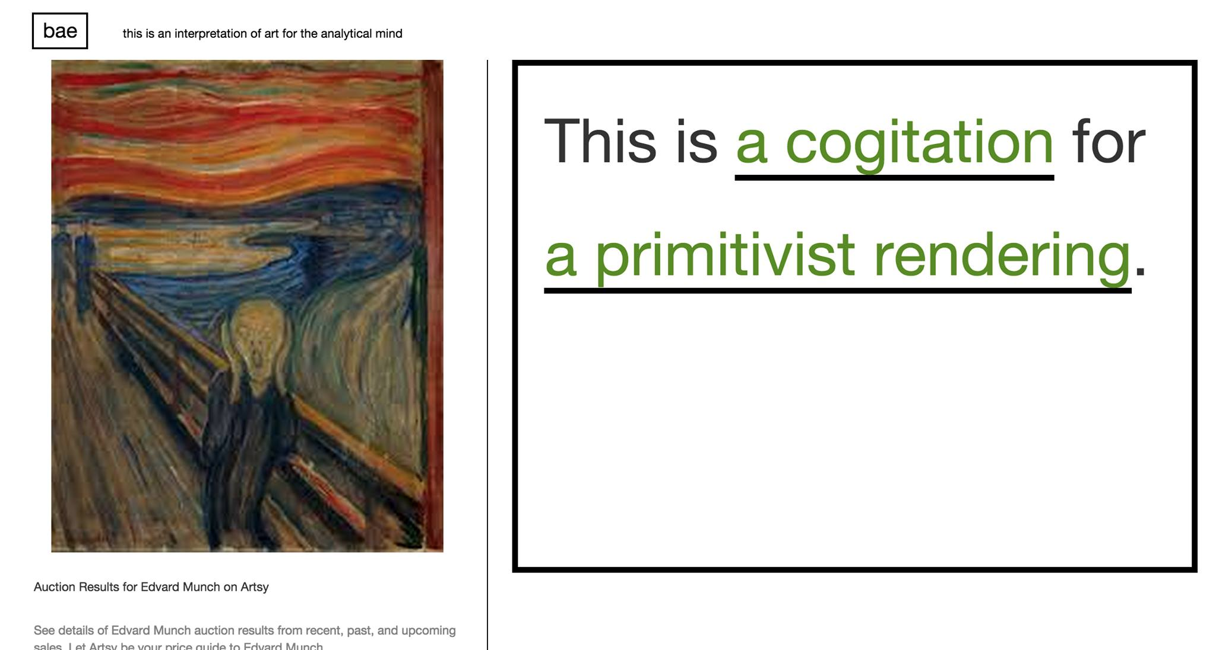

Slide 6
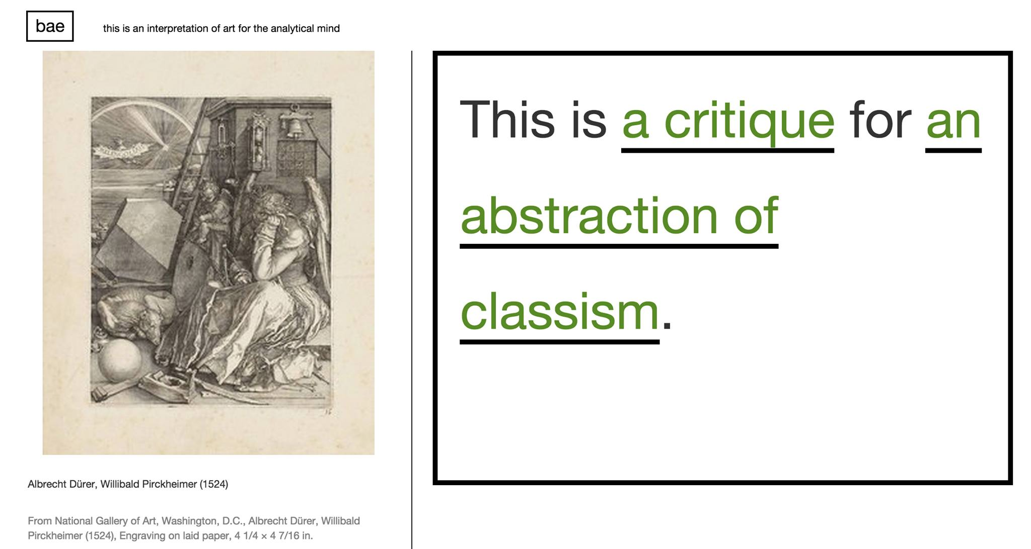

Slide 7
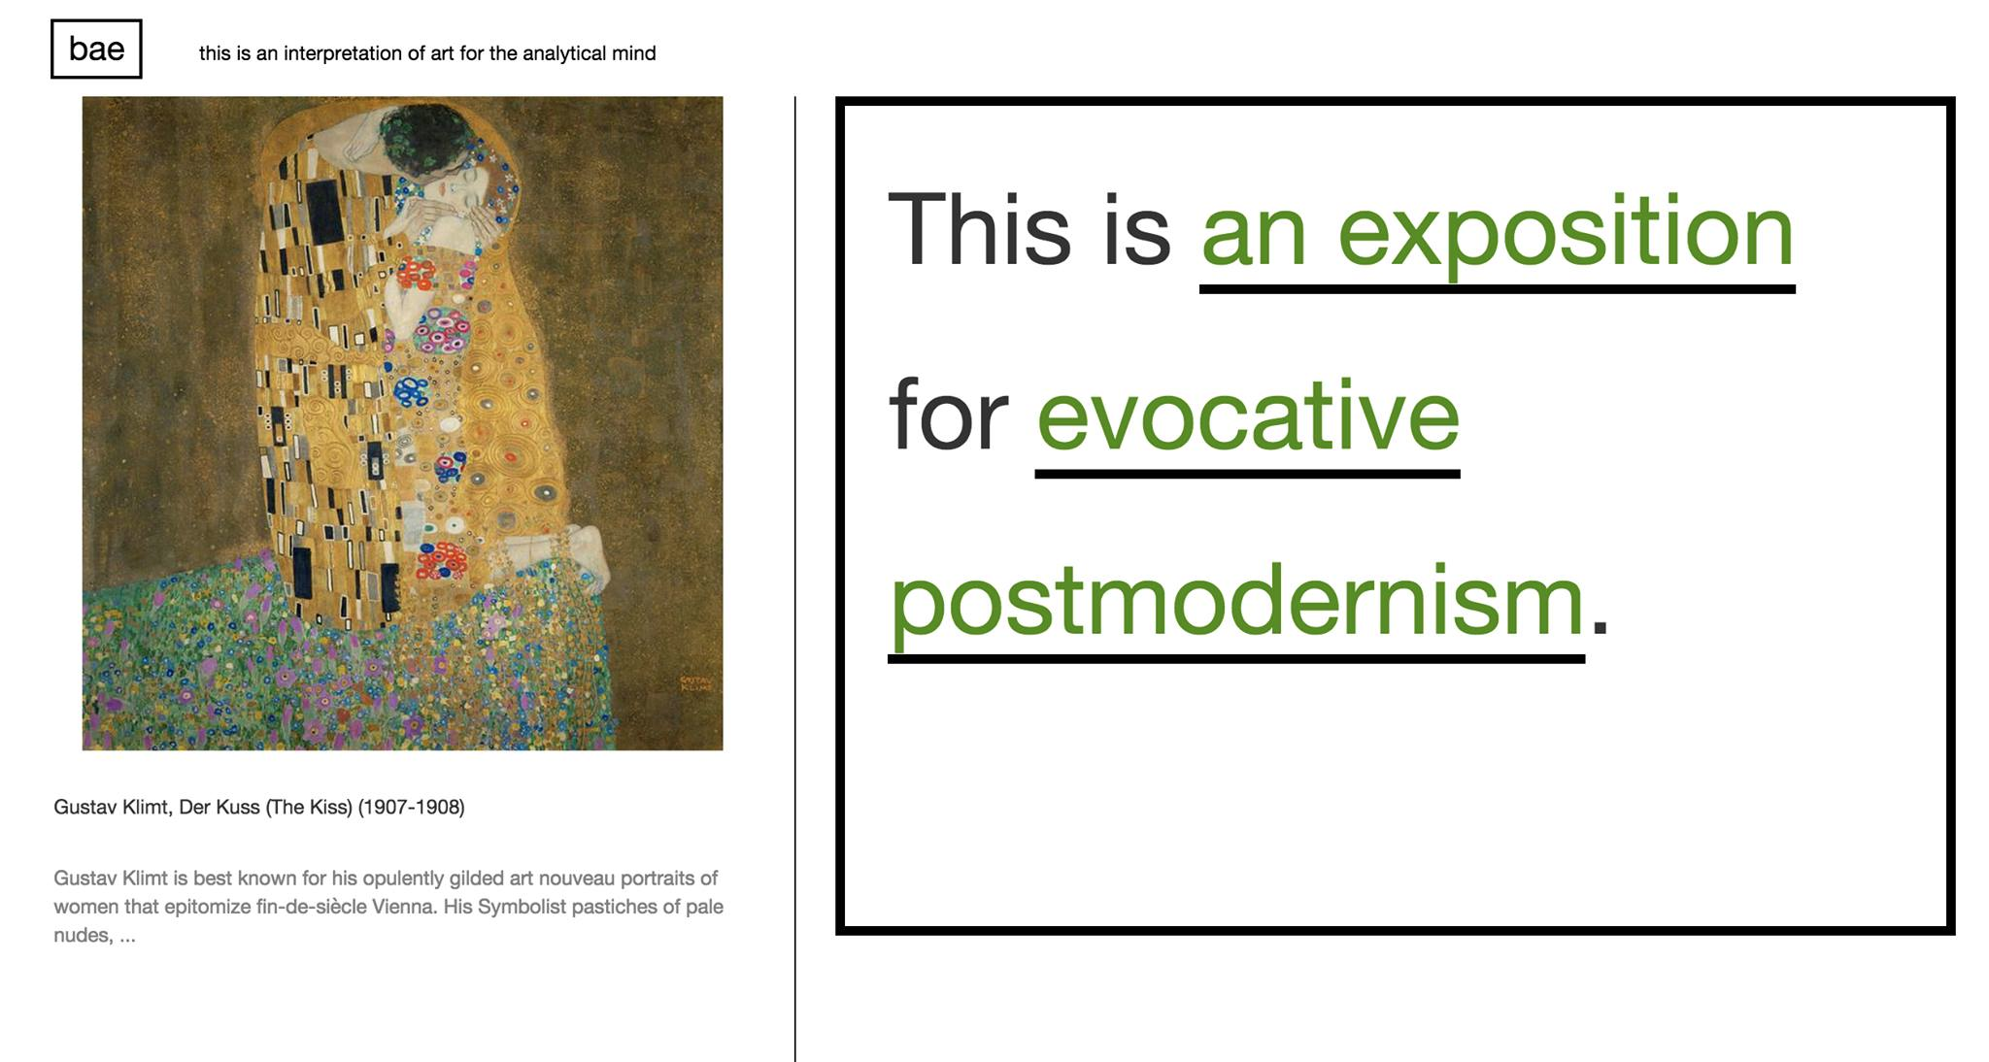

Slide 8
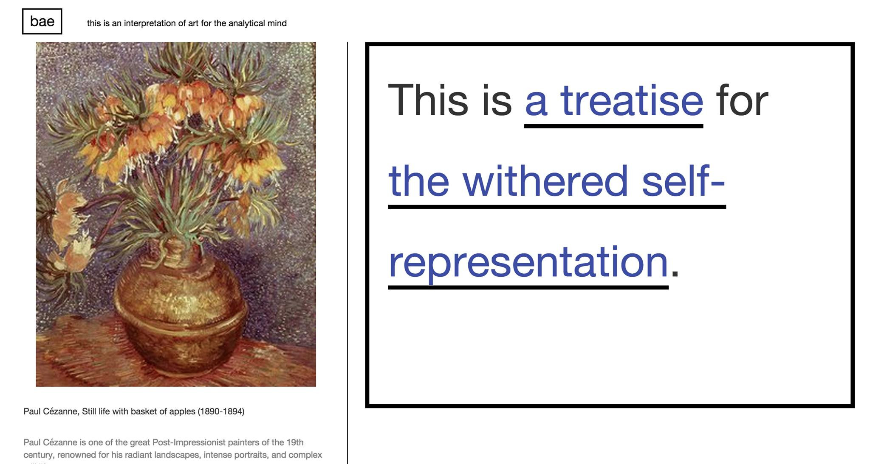

Slide 9
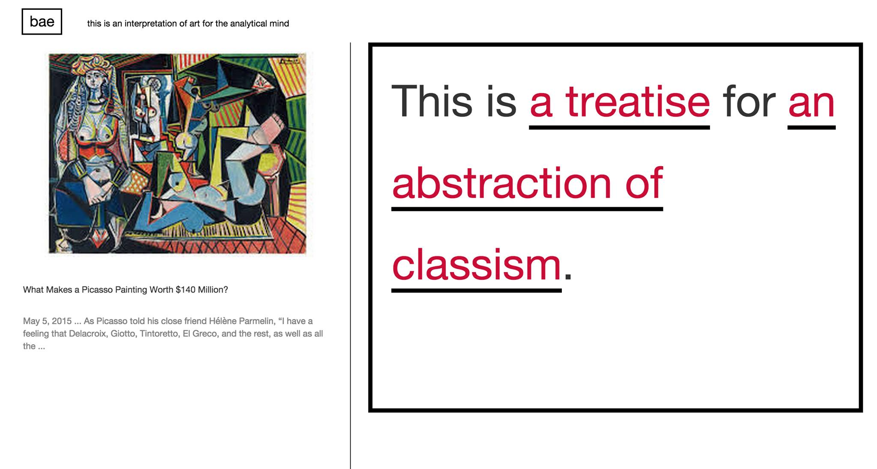

Slide 10
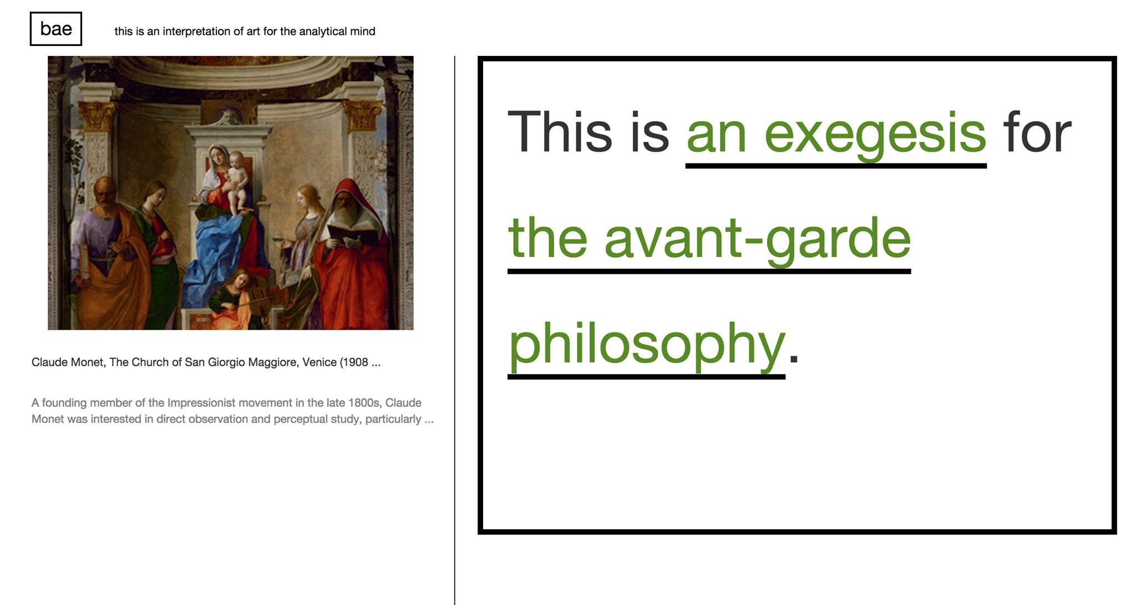

Slide 11
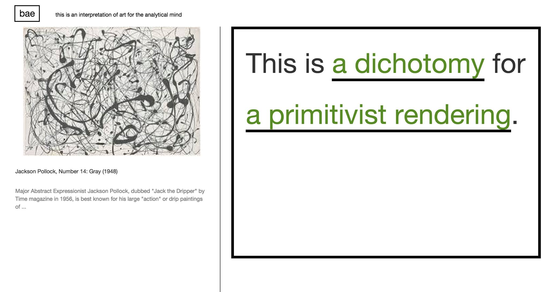

Slide 12
